Slide 1
IT CINEMA
By:
Kiran H
Kapil K
Punit A
Prassanna B
Srinidhi

Slide 2
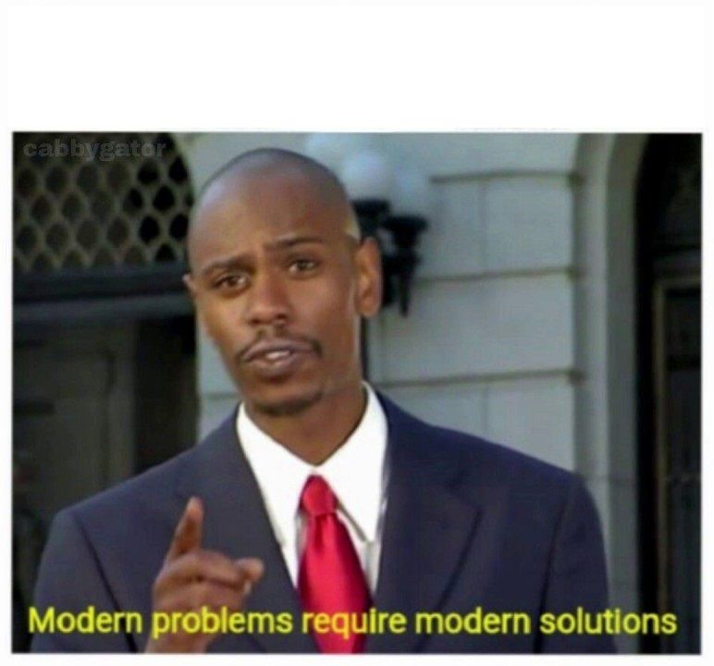
INTRODUCTION
Why IT Cinema?

Slide 3
CONTENTS
User View
Admin View

Slide 4
USER VIEW

Slide 5
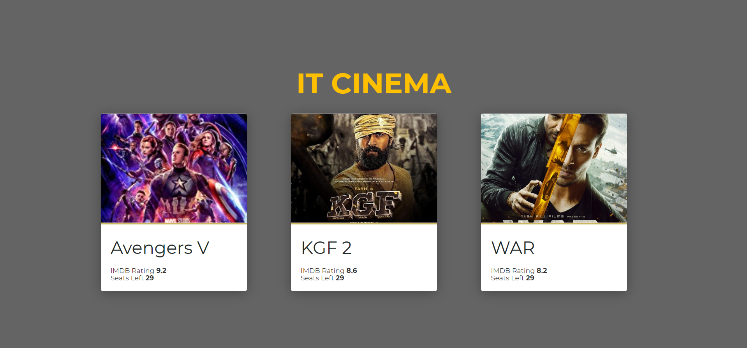
DASHBOARD

Slide 6
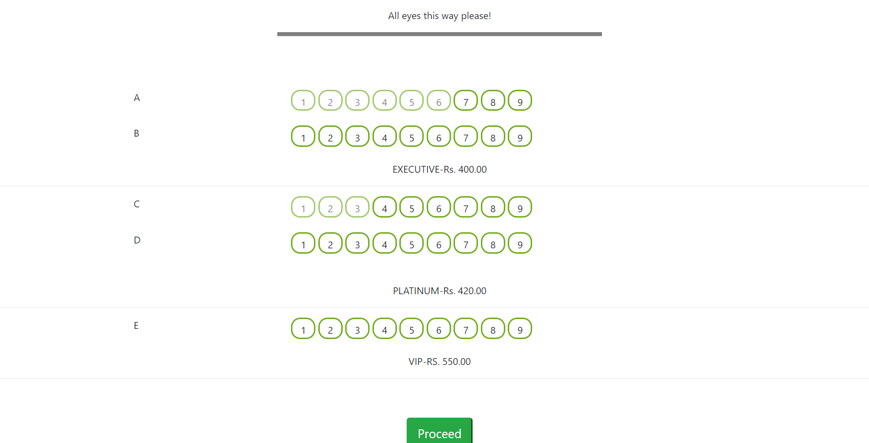
SEAT SELECTION

Slide 7
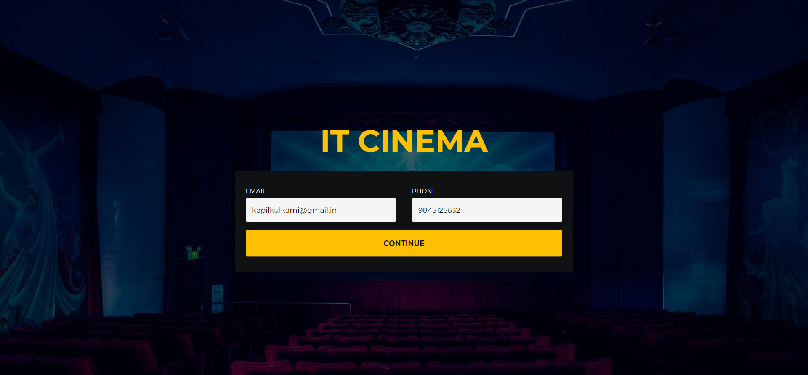
USER DETAILS

Slide 8
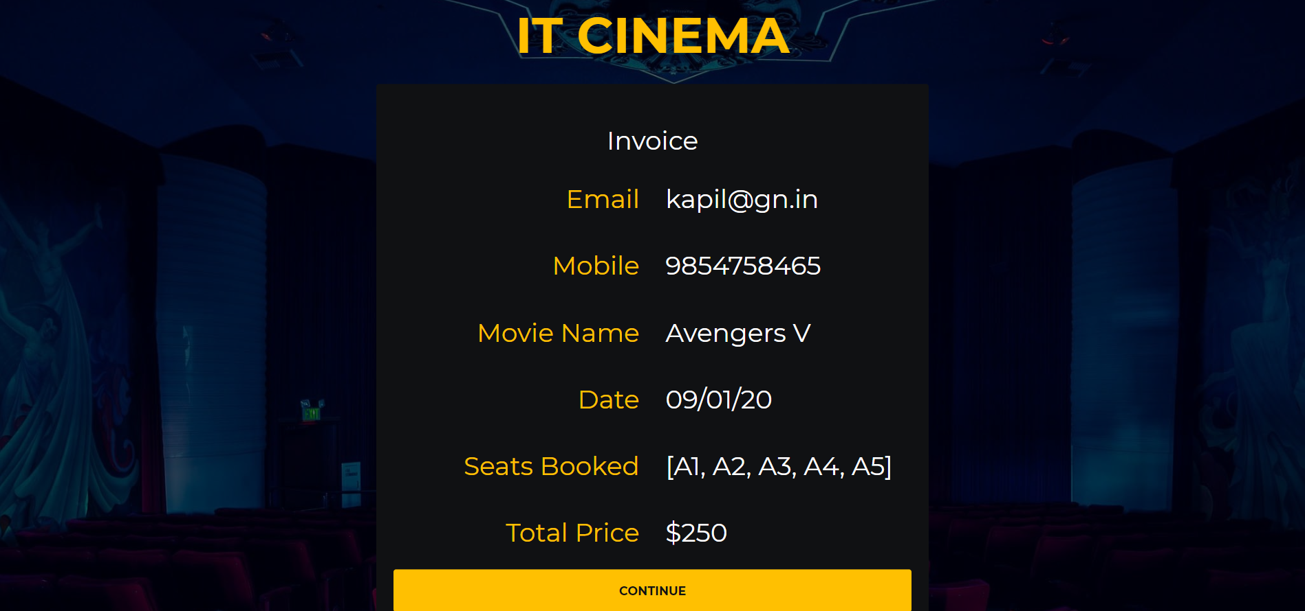
INVOICE

Slide 9
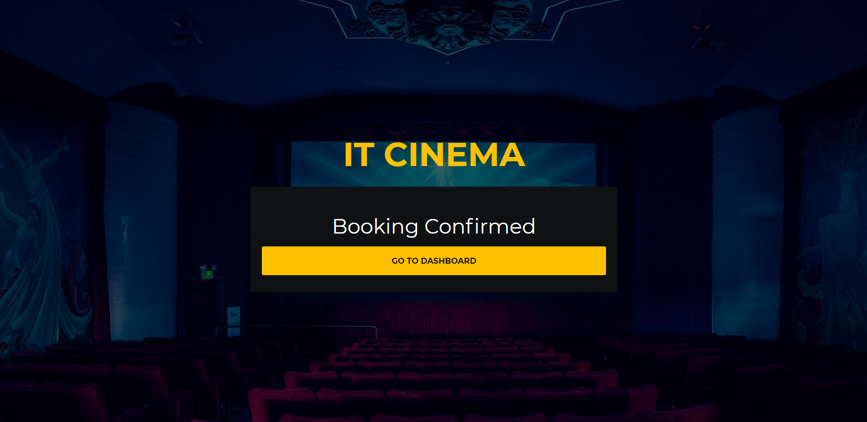
BOOKING CONFIRMATION

Slide 10
ADMIN VIEW

Slide 11
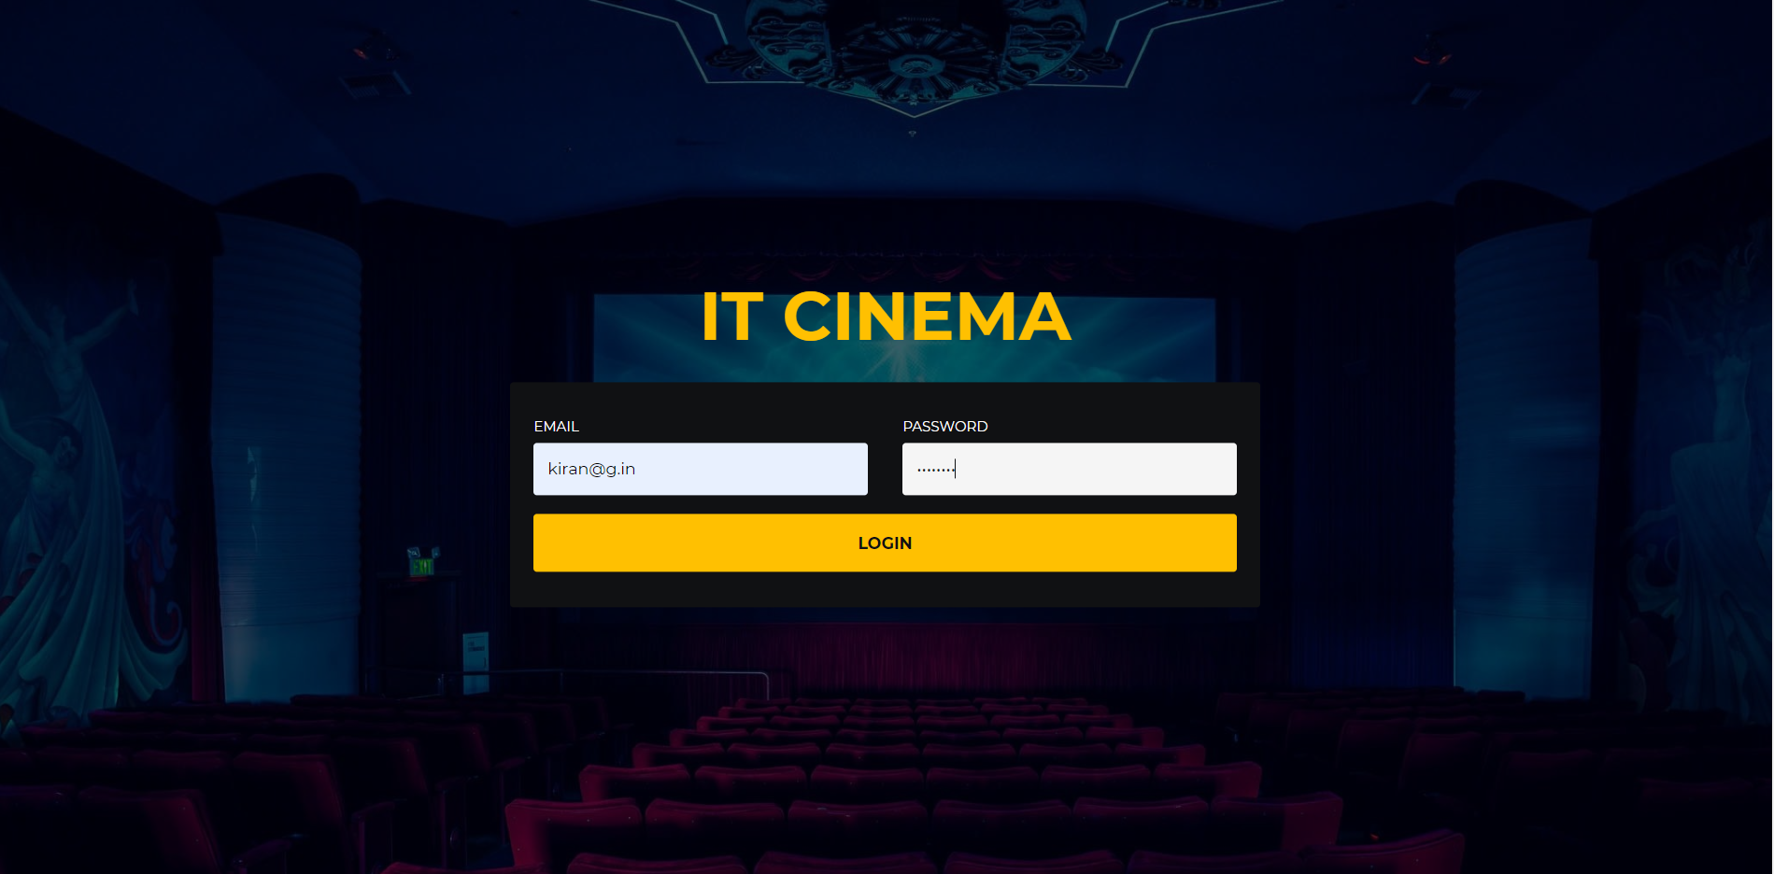
ADMIN FEATURES
Admin login

Slide 12
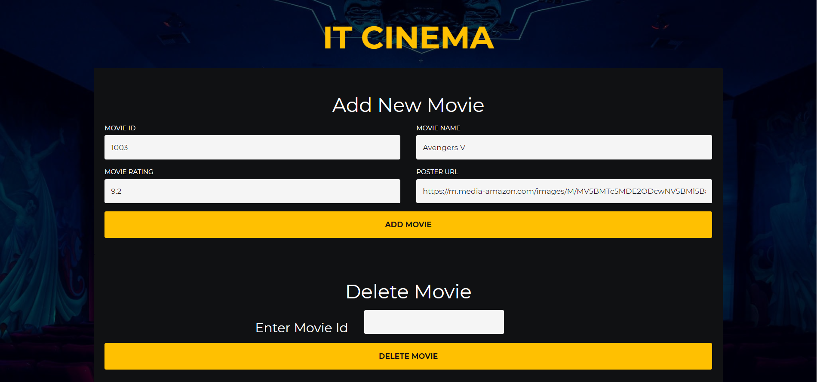
Add/Delete Movie

Slide 13
TABLE STRUCTURE
MovieTable
MovieId
MovieName
MovieRating
SeatsAvailable
PosterURL
AdminTable
AdminEmail
AdminPassword
BookingTable
UserEmail
UserMobile
MovieBooked
SeatsBooked
BookingDate

Slide 14
PROJECT WORKING

Slide 15
TECHNOLOGIES USED
HTML
CSS
Bootstrap
JavaScript
Java
Java Spring MVC
Oracle Database

Slide 16
FUTURE SCOPE

Slide 17
THANK YOU
IT Cinema
Where Stress comes to THE END.

